Slide 1
Welcome!
The Year 6 team:
Mrs Norton
Mrs Radburn
Mrs McIntyre
Miss Nicola

Slide 2
Year 6 subjects:
English
Maths
Science
RE
Music (coming soon!)
Computing
Geography
History
Art and DT
PE (Dates Weds and Fri)
Spanish

Slide 3
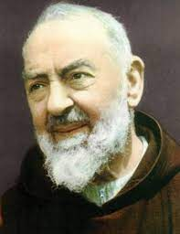
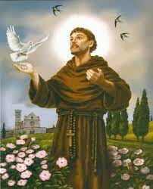
St Francis of Assisi
St. Padre Pio
Feast day:
23rd September

Slide 4
Dates:
SATS (KS2 tests):
Monday 10th May- Thursday 13th May
? Workshop:
Year 6 Residential:
6th June- 9thJune

Slide 5
Year 6 Expenses:
CGP Homework Books: For January
- Maths
-Reading
-SPAG

Slide 6
The Year 6 Curriculum

Slide 7
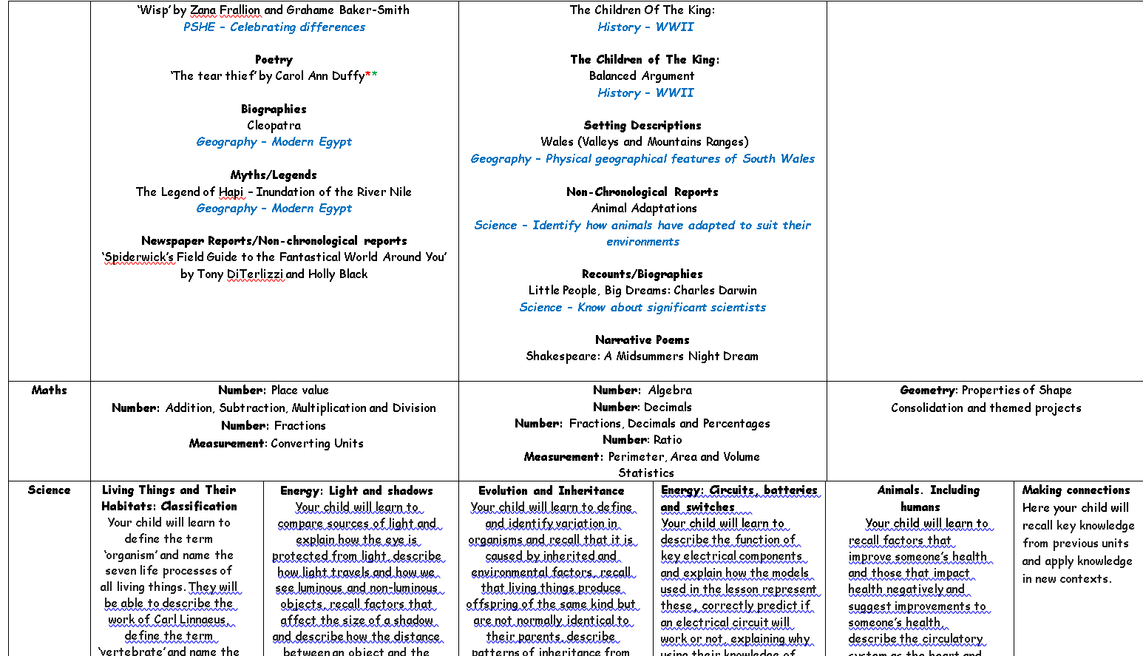
The Year 6 Curriculum

Slide 8
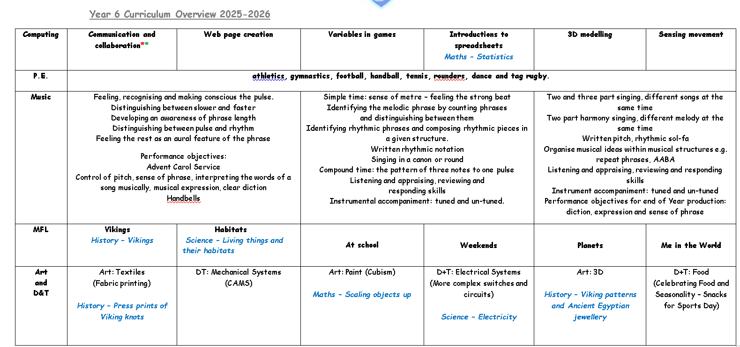

Slide 9

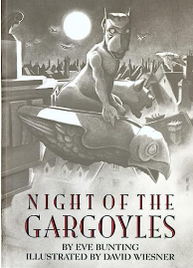




Year 6 Texts-

Slide 10
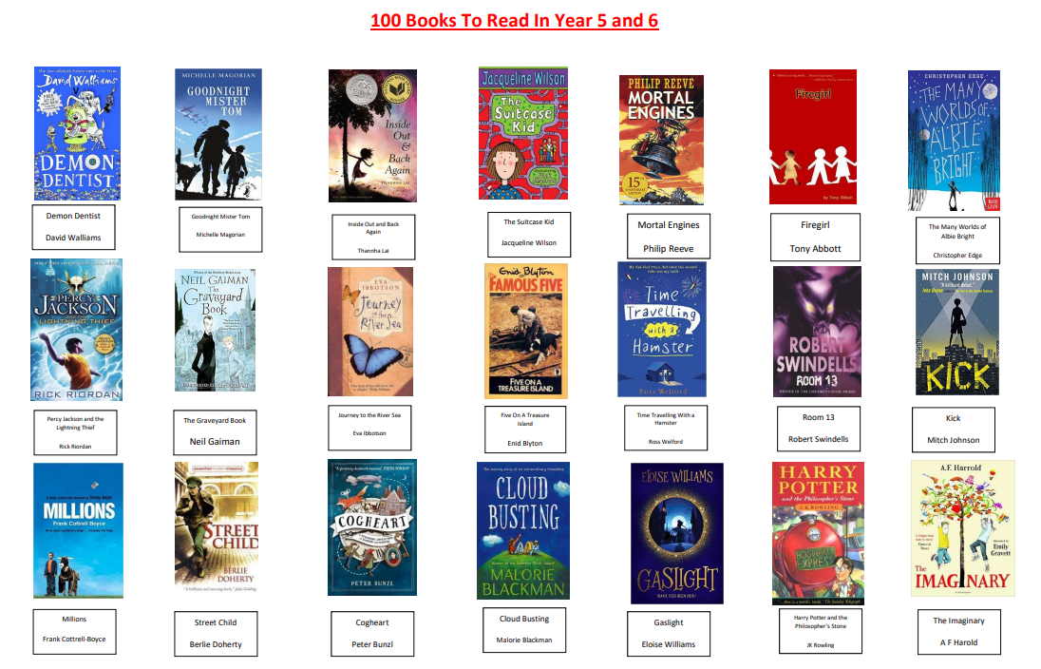

Slide 11
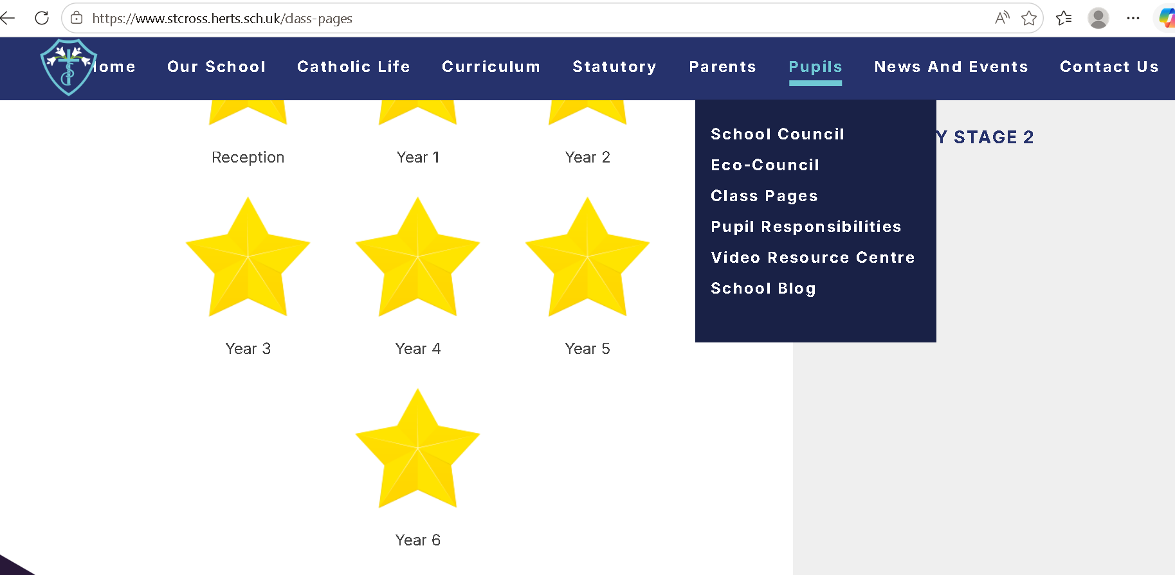

Slide 12
Homework
Homework set on a Friday, due the following Wednesday.
Spellings set on a Friday, and tested the following Thursday.
How to login
Atom-?
Provide login instructions
Reading
It is expected that children engage in reading for at least 15-20 minutes every night.
Reading
Please update your child’s reading record books (coming soon).
Maths: TimesTable Rockstars
Spag.com-from January.
Children MUST know times tables at speed-instant recall of these facts is vital.

Slide 13
Homework
Weekly:
Maths:
Science:
Reading:
Spelling:

Slide 14
Homework
Half-termly
RE Homework
This will be stuck into the children’s RE books in school, or displayed on the RE board.
We have high expectations in terms of quality, presentation and time taken to complete it.

Slide 15
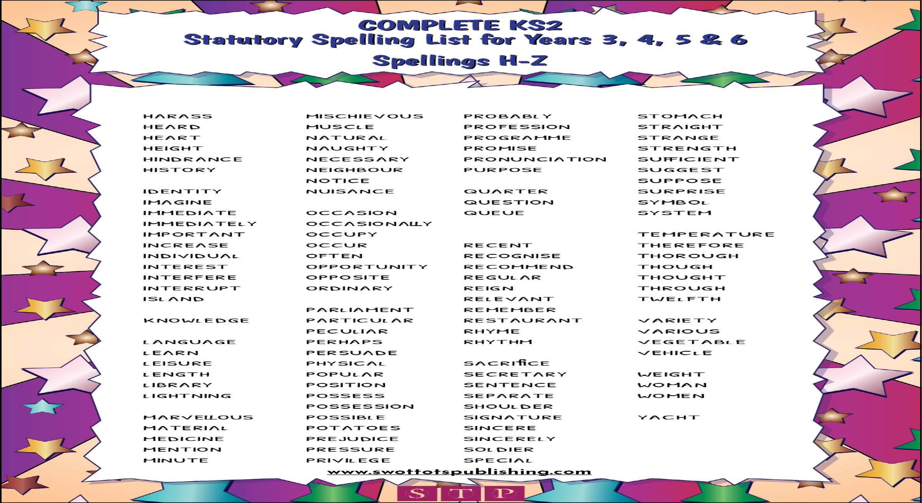
Spellings (tested on Thursday)

Slide 16
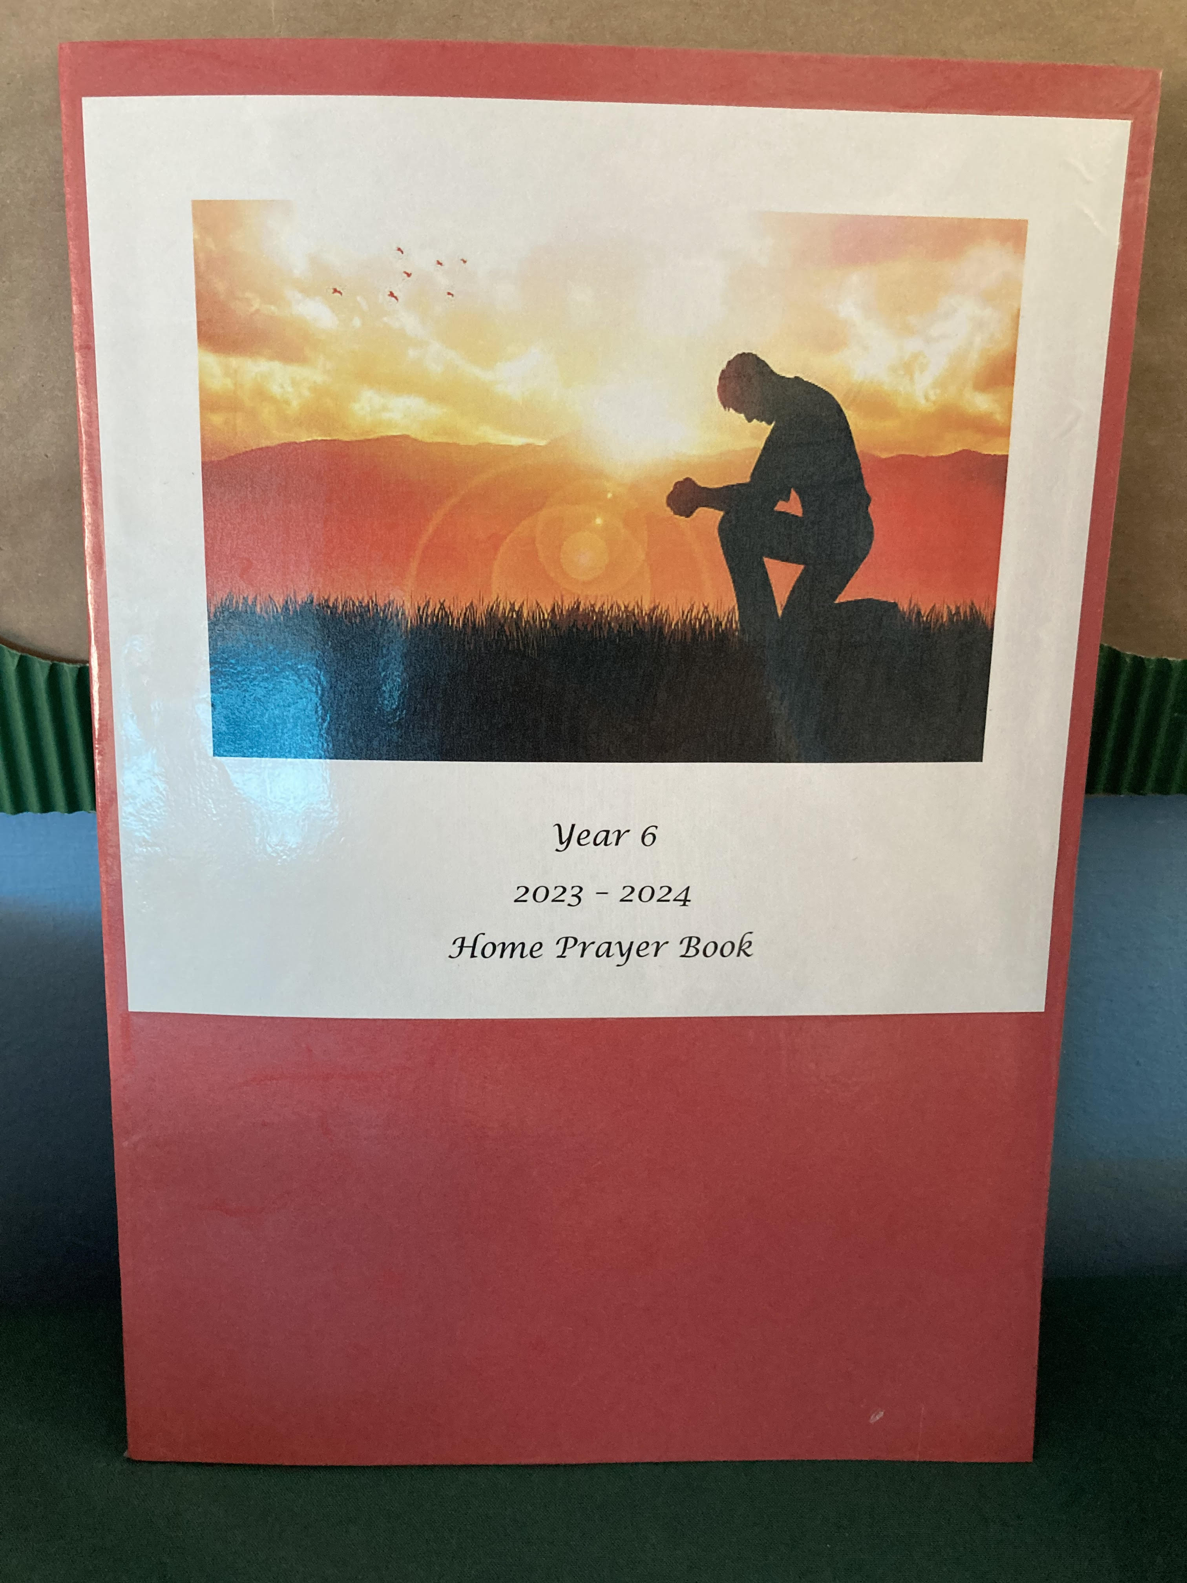
Year 6 Prayer Book
Around once a half term, your child will bring home the class prayer book to write in.
Please support them in writing thoughtful, reflective prayers, which are well presented and illustrated/decorated.

Slide 17
The Website
Signposts:
Every Friday, a weekly summary of Year 6’s week can be found via the website along with Spellings.
E-safety:
Social media and phone use in Year 6.

Slide 18

I am a Clever Writer

Slide 19
Thank you

