Slide 1
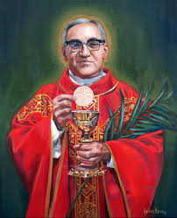
Welcome to Year 2!
Mrs James
Mrs Hill
Mrs Ives
Mrs Warren

Slide 2
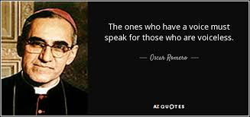
Class Saint – St Oscar Romero
Feast day – 24th March. Children will choose which charity they would like to contribute to.
An optional donation of £1 per child.
Prayer Book to go home daily.

Slide 3
Timetable
Mrs Hill will teaching on Monday, Wednesday and Thursday.
Mrs James will teach on Tuesday and Friday .
Mrs Ives and Mrs Warren will be in the classroom every morning.

Slide 4
Reading
Synthetic phonics scheme in Reception and Year 1 - Little Wandle. Phonics will be taught as a whole class recap until half term. Then move on to spelling strategies.
Children will choose a book to bring home and the level of these will be monitored to ensure they are appropriate for each child. This promotes a love of reading and sharing books.
Children will also have a Phonic book or a Fluency book depending on assessment.
Books do not have to change daily, but should be brought into school everyday.
Children will read daily in a group during Reciprocal Reading sessions.
Children will be heard read at least twice throughout the week.
Please continue to read daily with your child and comment using the reading diary to be provided.
Children may bring in a book from home.

Slide 5
PE
Tuesday and Friday– Mrs James
The Daily Mile to promote healthy lifestyle and emotional well-being.
PE kits to be worn to school on a PE day please. Jogging bottoms and jumpers may be worn when the weather turns colder.

Slide 6
Spellings
Spellings will be uploaded on to the Signposts document on a Friday and tested the following Thursday.
15 spellings will be set which will follow spelling patterns and children may learn 5, 10 or 15.

Slide 7
Other Homework
Maths homework will be set Anton weekly on a Friday.
When we get to the Spring term, children are encouraged to play Times Table Rockstars for 15 minutes 3 times a week. Logins will be given out.
RE – one piece at the end of every half term.

Slide 8
Signposts
On a Friday, a Signposts document will be uploaded to the website. This will give an overview of our learning throughout the week plus the spellings and RE homework.

Slide 9
Possible Enrichment Opportunities
Spring term – Possible trip to The Gunpowder Mills linked to history, science and English topic.

Slide 10
As always if you have an questions or concerns then please catch us at the end of the day or make an appointment via the school office

Slide 11
Thank you for listening!

