Slide 1
Welcome to Year 4
Miss Kendrick
Mrs Piacquadio
Miss Judge

Slide 2
Class Saint – St Maximillian Kolbe
Our class saint is St Maximillian Kolbe.
Feast Day: 14th August
Throughout the year, we will learn about St Maximillian’s Kolbe’s life and the values he demonstrated, including courage, faith and selflessness.

Slide 3
Timetable
Teaching Team
- Miss Kendrick – class teacher
- Mrs P – teaches Year 4 every Tuesday
- Mrs Piacquadio – supports learning on Monday, Tuesday, Thursday and Friday mornings
- Miss Judge – supporting learning every morning

Slide 4
Reading
Children will choose a reading book, with levels carefully monitored to ensure an appropriate level of challenge and support.
Children will be heard read regularly throughout the week.
Please read with your child every day and record any reading in their reading record.
Regular reading at home is one of the most effective ways to support your child’s progress and develop a lifelong love of reading.

Slide 5
PE
PE lessons will take place every Thursday and Friday.
Children should come to school wearing their PE kit on both PE days.
During colder weather, children may wear plain jogging bottoms and a jumper to ensure they are warm and comfortable during outdoor sessions.

Slide 6
Spellings
Spellings will be uploaded to the weekly Signpost every Friday, and tested the following Thursday.
To encourage independence and challenge, children may choose to learn 5, 10 or all 15 spellings.
We encourage children to practise regularly throughout the week to help them apply these spellings confidently in their writing.

Slide 7
Homework
Homework will be uploaded on Atom Learning every Friday and will be due in the following Thursday.
Homework will alternate weekly between English and Maths.
An additional Science homework task will be set every other week.
Each half-term, children will complete an RE homework project. Full details will be shared via the weekly Signpost.

Slide 8
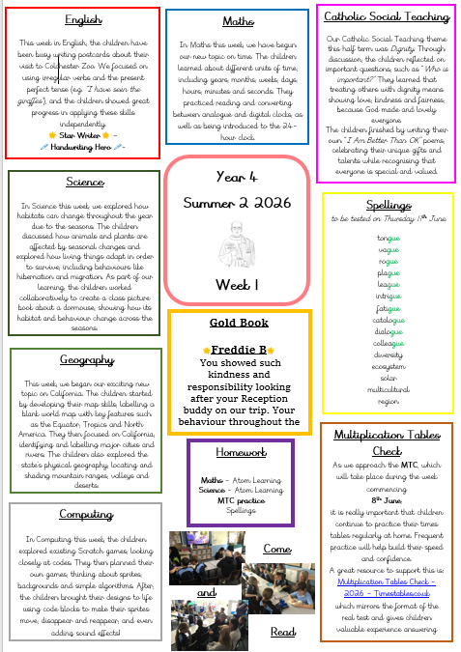
Signposts
Every Friday, a Signpost will be uploaded to the school website.
This will provide:
- A summary of the week’s learning,
- Weekly spellings,
- Homework information,
- Key reminders and dates,
- Class news and photos

Slide 9
Enrichment Opportunities
At St Cross, we believe learning extends beyond the classroom.
Throughout the year, pupils will have opportunities to take part in enriching experiences designed to bring the curriculum to life, develop confidence and create lasting memories.
Possible opportunities may include: educational visits, visitors and workshops in school, sporting events and competitions, library visits, etc.
Please note: Visits and activities may vary from year to year depending on availability and curriculum needs.

Slide 10
Thank you for listening ☺

