Slide 1
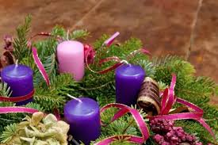
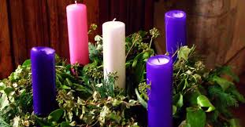
advent
By Cillian and Mollie

Slide 2
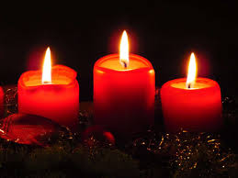
Someone will now light the candle.
Why do we light the candle?

Slide 3

Why do we wear purple ribbons?

Slide 4
Why do we wear purple ribbons?
We wear purple ribbons to represent Advent.

Slide 5
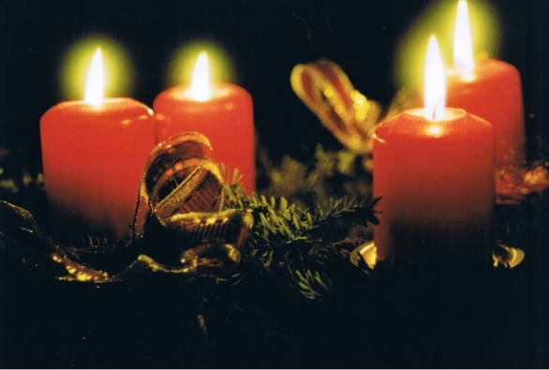
ADVENT
What is Advent?
Advent is the 4 weeks following up to the day Tesus was born and we wear purple ribbons to show it.

Slide 6
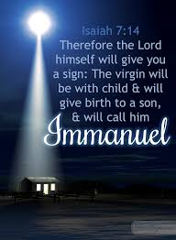
Mrs Ciftci will now read the bible
Isaiah 7:14-16

Slide 7
Questions
  Who is the young woman?
  Who is the son?

Slide 8
Answers
Who is the young woman? Mary.
Who is the son? Jesus.

Slide 9
Prayer
God of hope, we are sometimes afraid, but you are always with us showing us the way.
Please hear our prayers of hope.
Amen

Slide 10


