Slide 1
International peace day
Welcome to our assembly
By Aeda and Katie

Slide 2
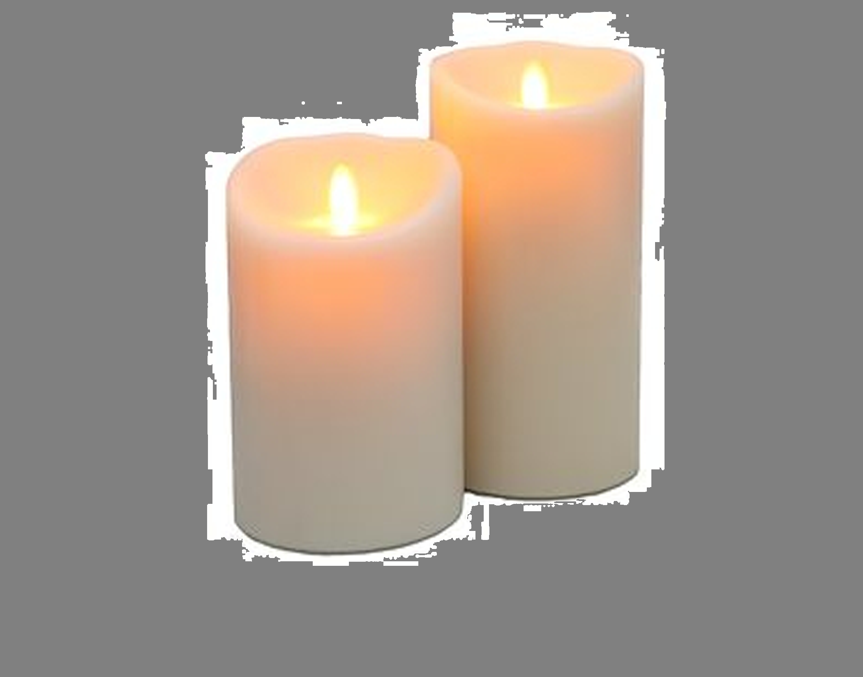
Now Aeda will light the candle.
Why do we light the candle?

Slide 3

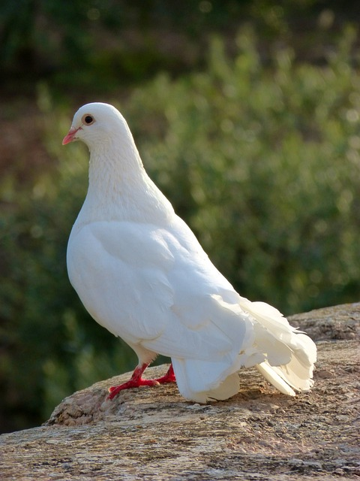
International peace day was made in 1981 , to commemorate and strengthen the ideas of peace of both within and among all nations and people.
A dove is the sign for peace!

Slide 4
Celebration
It is celebrated annually on 21st September.

Slide 5
Questions:
. How can we make peace in the school?
. What does peace mean to you?
. When was international peace day made?
PEACE!

Slide 6
We invite you to put your hands together.
Dear God,
Please help us to make the right choices so that peace will be around us.
Help those in war , and bring peace to all countries .
Guide us to do good actions to make a peaceful world.
Amen.

Slide 7
Thank you for listening !

