Slide 1
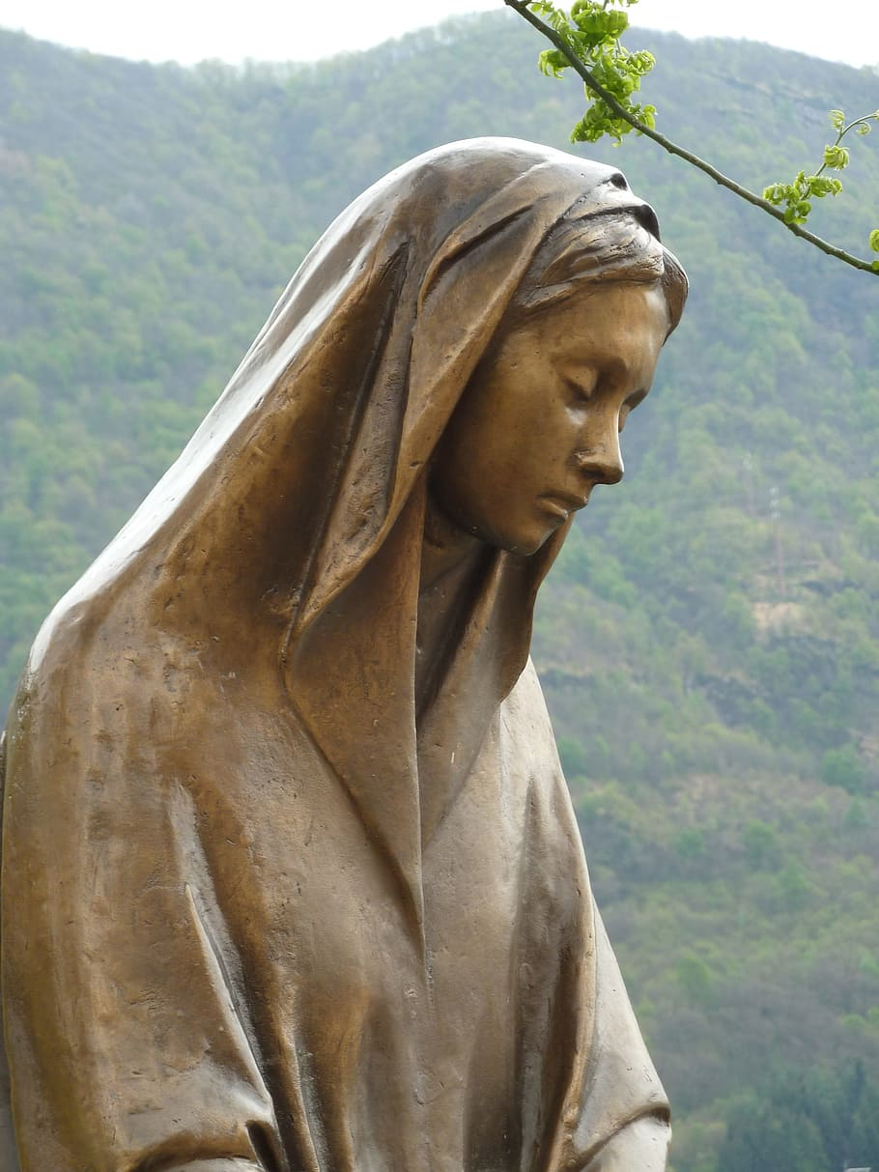
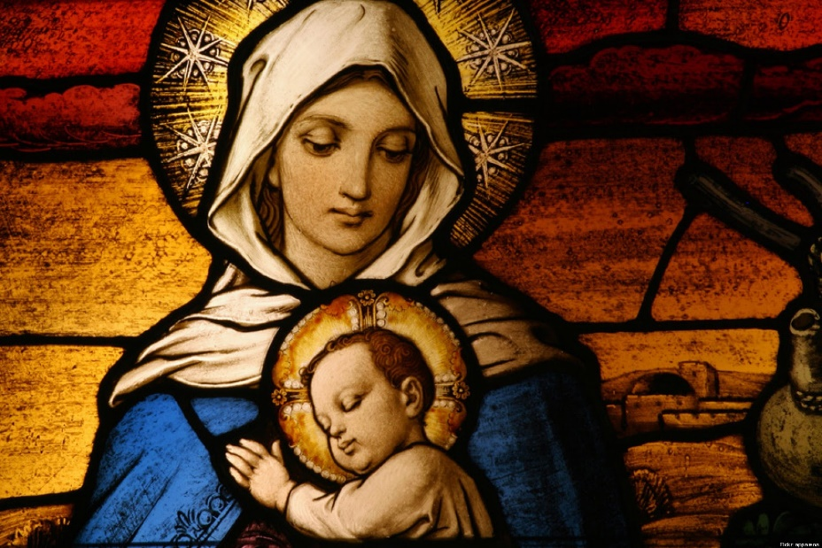
Month of Mary
By Cillian and Mollie

Slide 2
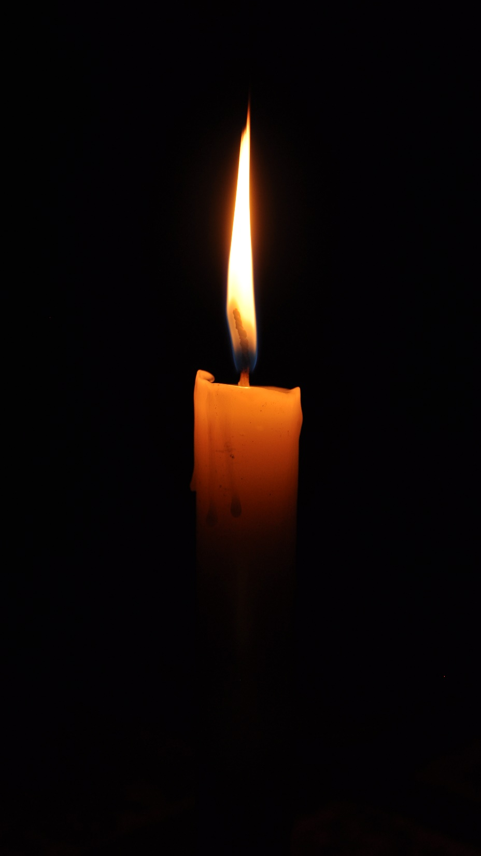
Mollie will now light the candle
Why do we light the candle?

Slide 3
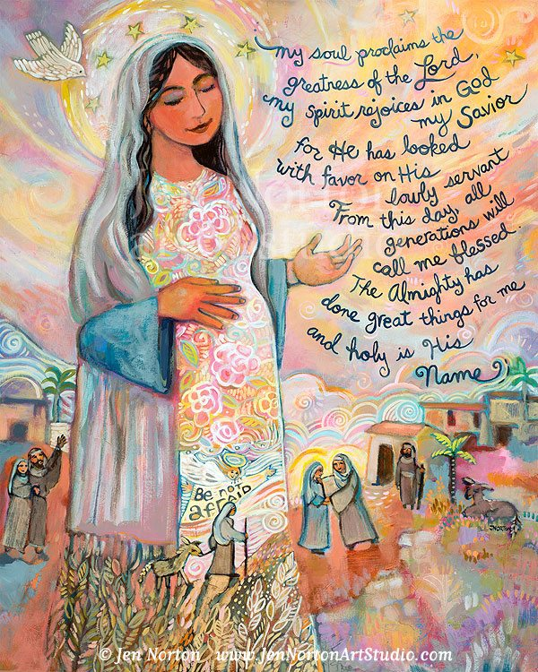
Mrs James will now read the bible
Gospel Luke 1:46-56

Slide 4
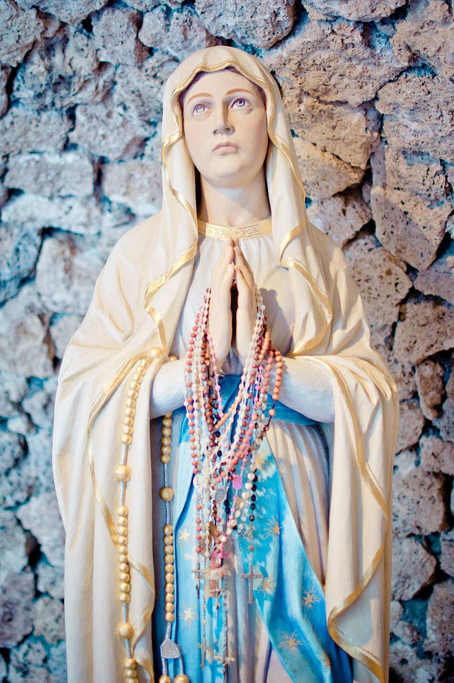
Question
Why was Mary happy?

Slide 5
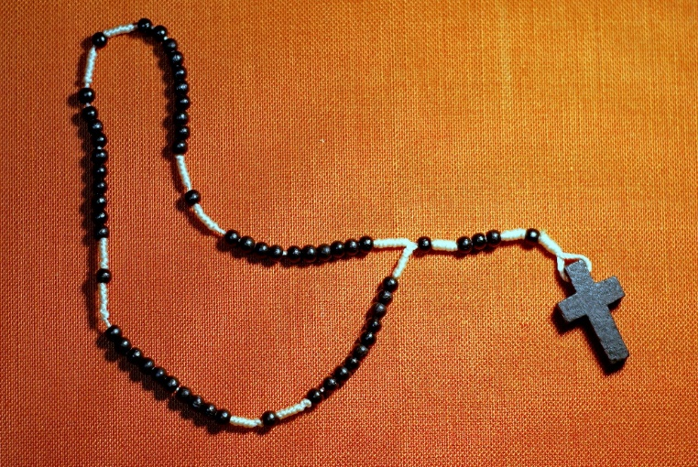
Rosary
Why do we do the Rosary?
Does anyone know which prayers we say when we pray the Rosary?
The Rosary is a way to reflect and think about Mary.

Slide 6
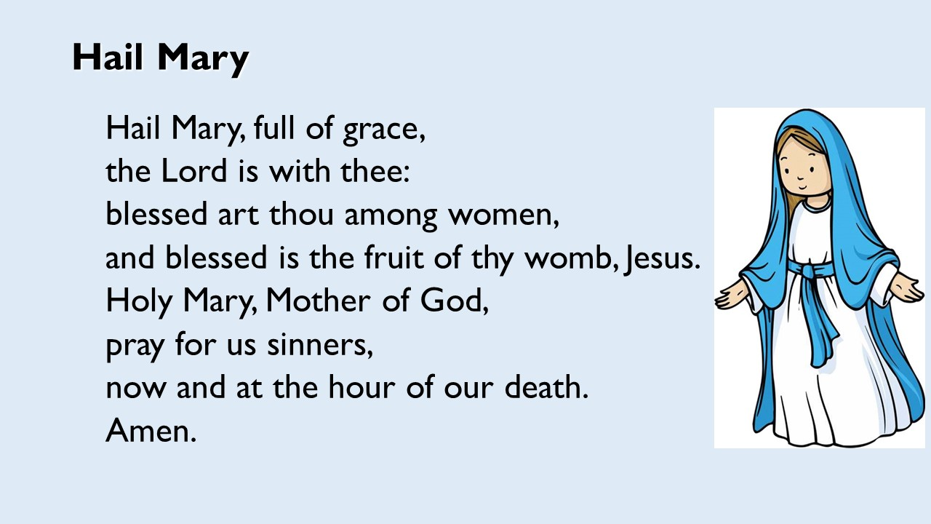

Slide 7

Does anyone have questions?

Slide 8


