Slide 1
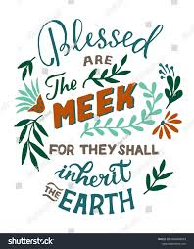
BLESSED ARE THE MEEK
Matthew 5:5
By Katie and Aeda.

Slide 2
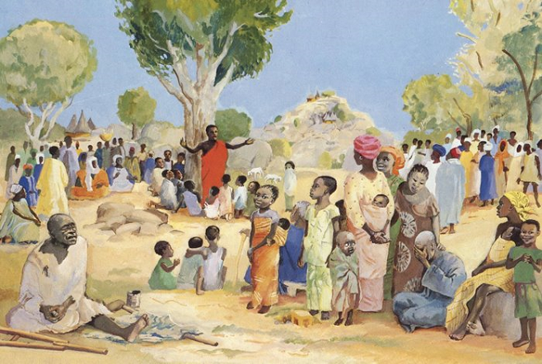
Beatitudes
Jesus taught the Disciples about the 8 Beatitudes while teaching on the mount.
The Beatitudes are 8 blessings and ways in which we should live.

Slide 3
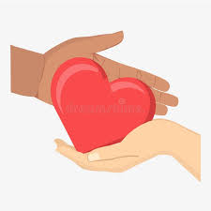
Blessed are the meek
What do you think the word ‘meek’ means?
Meek means to be humble, kind and gentle, rather than pushing to get more, because they know God will one day give them everything.

Slide 4
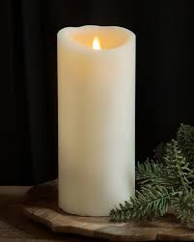
Who would like to light the candle?

Slide 5
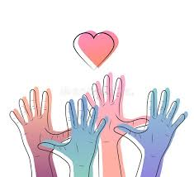
Matthew 5:5
“Happy are those who are humble;
they will receive what God has promised!...

Slide 6

What does it mean to be meek?
Most people think: ‘I’m Number 1!’
But a meek person is humble. They know God is number 1.

Slide 7
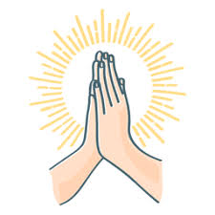
Let’s pray
Dear Jesus,
thank you for providing the perfect example of meekness by coming to earth and dying for us.
Please help us to live meek, humble lives as we follow you, remembering that you are Number 1.
Amen.

