Slide 1
Welcome!
The Year 6 team:
Ms Daniels
Mrs Kew
Mrs Bowen

Slide 2
Year 6 subjects:
English
Reciprocal Reading
Maths
Science
RE
Music
Computing
Geography
History
Art and DT
Music
PE (swimming Autumn 1)
Forest School
Spanish

Slide 3
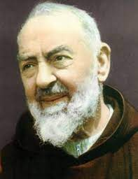
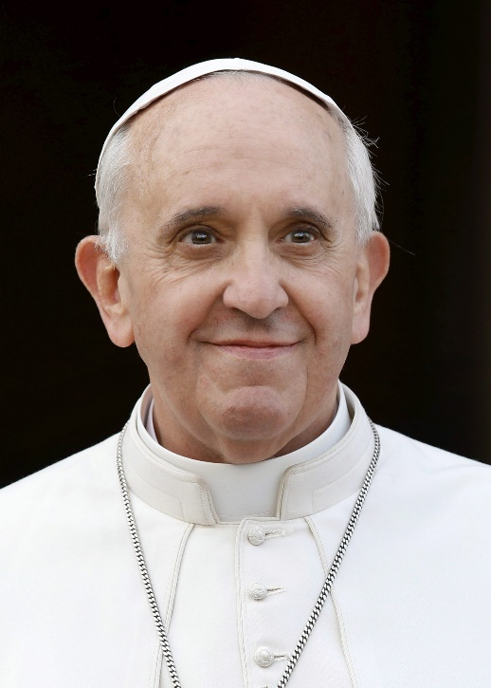
Pope Francis
St. Padre Pio
Feast day:
23rd September
£1 per child
Strapline: ‘Let us always pray for one another.’

Slide 4
Dates:
Virtual Viking Workshop: TBC
SATS (KS2 tests):
Monday, May 12th, to Thursday, May 15th
Shakespeare Workshop: TBC
Year 6 Residential:
Monday 2nd to Friday 6th June

Slide 5
Year 6 Expenses:
CGP Homework Books: (£25 through school, £40 through Amazon)
- Maths (Arithmetic and Reasoning)
-Reading
-SPAG
Virtual Viking Workshop: £10
Shakespeare Workshop: Spring 2023, Approx. £5-10
Leavers Hoodies and Books: Approximately £30
Residential: £557

Slide 6
The Year 6 Curriculum
Some links across the curriculum for Autumn:
English:
Guides
A Guide to Keeping Your Body Healthy *
Science – Animals Including Humans
‘Wisp’ by Zana Frallion and Grahame Baker-Smith
‘The Tear Thief’ by Carol Ann Duffy **
PSHE – Celebrating differences
Biographies
Cleopatra
Geography – Modern Egypt
The Legend of Hapi – Inundation of the River Nile
Geography – Modern Egypt

Slide 7
The Year 6 Curriculum
Some links across the curriculum for Autumn:
Science:
Animals Including Humans
-Healthy Living Guides
Computing:
3D Modelling
-Geography – Modern Egypt
Art:
Textiles
-History – Press prints of Viking knots
Art:
3D clay
-Geography – Modern Egypt

Slide 8






Year 6 Autumn Texts

Slide 9
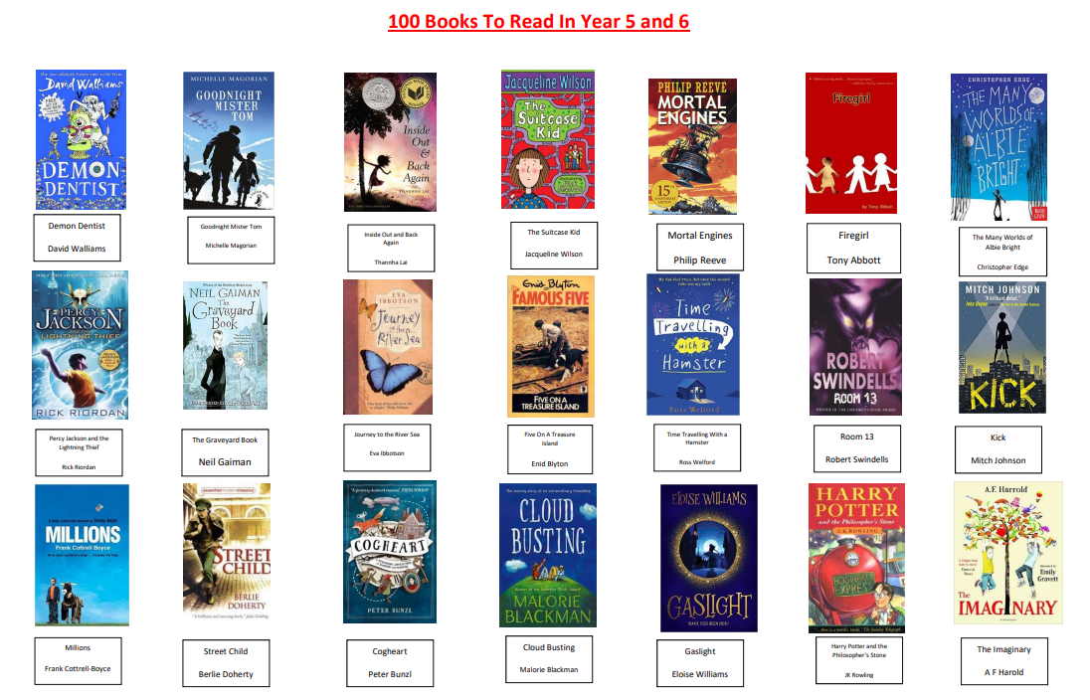

Slide 10
Homework
Update:
Homework set on a Friday, due the following Thursday.
Spellings set on a Friday, and tested the following Thursday.
Daily:
Reading
It is expected that children engage in reading for at least 15-20 minutes every night.
Please update BoomReader daily- it will be checked everyday.
BoomReader
Please update your child’s reading via the app, which I am then able to access from school.
Maths: TimesTable Rockstars
Children MUST know times tables at speed-instant recall of these facts is vital.
500 calculations per week

Slide 11
Homework
Weekly:
Atom
-Two tasks (+) set per week, due on Thursdays.
Spellings
- x 15 spellings which follow a pattern.
SPaG (CGP) from Spring 1

Slide 12
Homework
Half-termly
RE Homework
This will be detailed on the weekly signpost.
Homework is half-termly.

Slide 13
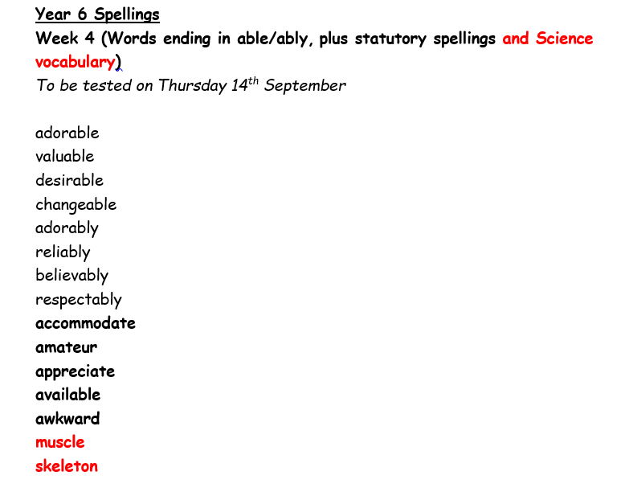
Spellings (tested Thursday)

Slide 14
Year 6 Prayer Book
Around once a half term, your child will bring home the class prayer book to write in.
Please support them in writing thoughtful, reflective prayers, which are well presented and illustrated/decorated.

Slide 15
The Website
Signposts:
Every Friday, a weekly summary of Year 6’s week can be found via the website along with Spellings.
Photos:
The website will be frequently updated with photos of what the children are doing in school.

Slide 16
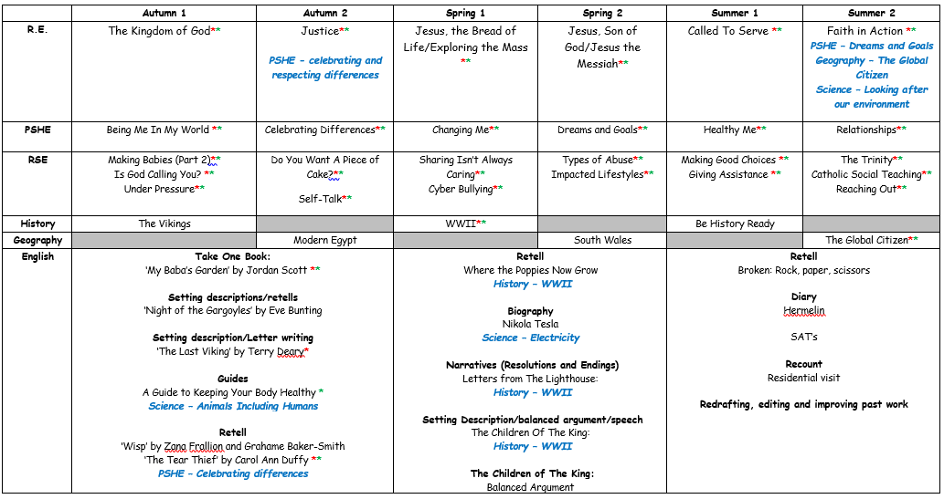
Overview

Slide 17
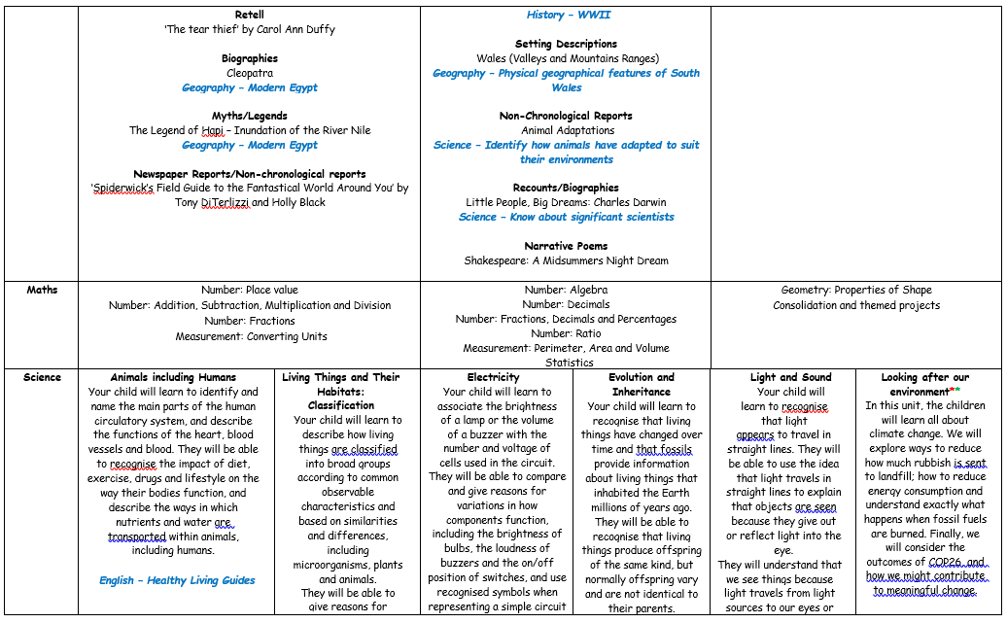

Slide 18
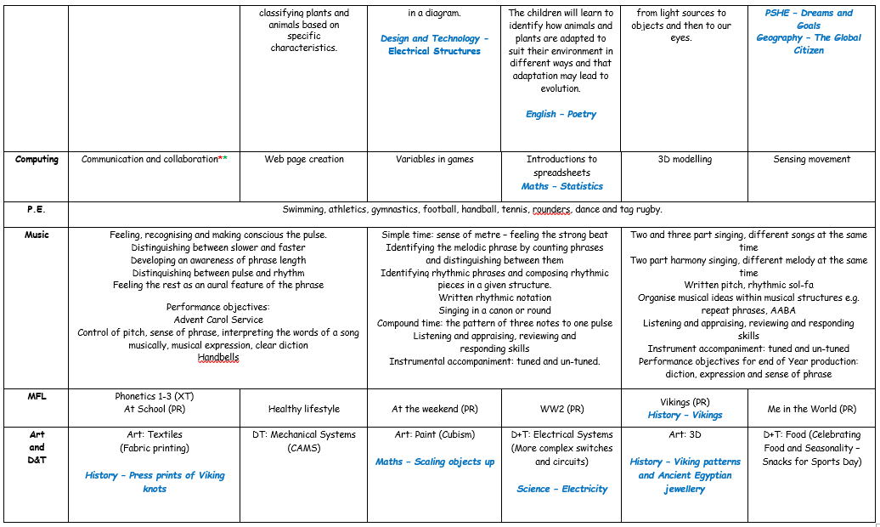

Slide 19

Questions

Slide 20
Thank you

